Slide 1
Lecture 1 – AI: An Overview & Python Basics
AY 2024-25

Slide 2
On completion of the module, students are expected to be able to:
Module Intended Learning Outcomes
Explain the basic principles of artificial intelligence technologies;
Evaluate and select appropriate machine learning technologies; and
Design and prototype AI/machine learning applications to solve real-life problems.

Slide 3
Module Plan
AI: An Overview & Python Basics
Data Analysis with Python
AI Search Techniques
Logic Programming & CSP
Probabilistic Reasoning
ML – Classification
ML – Regression & Clustering
Computer Vision & AI Cloud Services
Natural Language Processing
Recommender Systems
DL – Basic ANN
DL – CNN & RNN

Slide 4
Lesson Outline
L1 – AI: An Overview & Python Basics
Artificial Intelligence: An Overview
Python Basics
Colaboratory
Python Language Basics

Slide 5
1. Artificial Intelligence: An Overview
What is Artificial Intelligence?
History of Artificial Intelligence
AL vs Traditional Computing
Common Domains of AI
Applications of Artificial Intelligence

Slide 6
What is Artificial Intelligence?
The term Artificial Intelligence was first coined decades ago in the year 1956 by John McCarthy, Father of AI.
He defined AI as:
“The science and engineering of making intelligent machines.”
In other words, Artificial Intelligence is the science of getting machines to think and make decisions like humans.

Slide 7
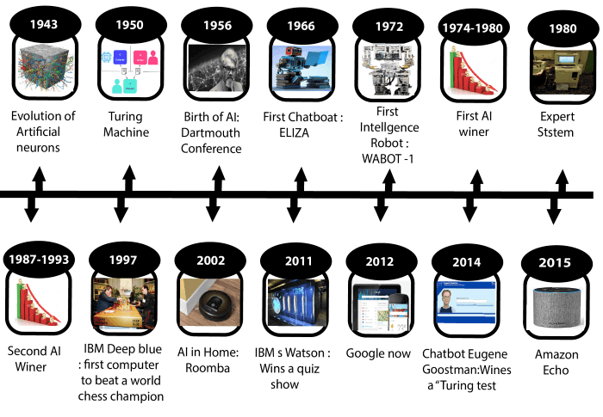
History of Artificial Intelligence
An AI Timeline

Slide 8
History of Artificial Intelligence (2)
Highlights of important events:
1943: Artificial Neurons
1950: Turing Machine (Alan Turing)
1956: Father of AI (John McCarthy)
1964: Pioneering chatbot: ELIZA
1974-1980 First AI Winter
1980 Expert Systems
1987-1993 Second AI Winter
1997 IBM's Deep Blue (World Chess Champion)

Slide 9
History of Artificial Intelligence (4)
Highlights of important events (cont.):
2002 Roomba
2011 Apple's Virtual Assistant: Siri
2014 Chatbot: Eugene (Passes Turing Test)
2014 Amazon's Virtual Assistant: Alexa
2016: Google's AlphaGo (World Chess Champion)

Slide 10
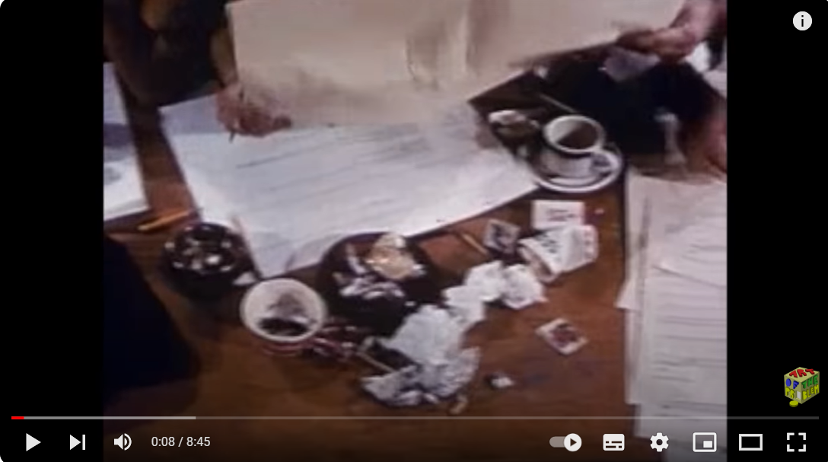
Turing Machine
A Turing machine is a theoretical device that was proposed by the mathematician and computer scientist Alan Turing in 1936.
It is a mathematical model of a general-purpose computer and serves as a fundamental concept in the theory of computation.
Link: https://www.youtube.com/watch?v=-ZS_zFg4w5k

Slide 11
The Turing Test
proposed by Alan Turing in 1950, is a test of a machine's ability to exhibit intelligent behavior indistinguishable from that of a human.
In the original formulation of the Turing test, a human evaluator engages in a text-based conversation with two entities: a human and a machine.
Link: https://www.youtube.com/watch?v=sXx-PpEBR7k

Slide 12
Programming Paradigms
Declarative Programming
Imperative Programming

Slide 13
Declarative Programming
Declarative programming is a programming paradigm that focuses on describing the desired result or outcome of a computation, rather than specifying the sequence of steps that should be performed to achieve that result.
It emphasizes what the program should accomplish, rather than how it should be done.

Slide 14
Imperative Programming
Imperative programming is a programming paradigm that focuses on explicitly specifying the sequence of steps or instructions that a computer should follow to solve a problem.
It emphasizes how the computation should be performed, rather than solely focusing on the desired outcome.

Slide 15
AI vs Traditional Computing
AI: focuses on what to do → Declarative programming
Traditional Computing: focuses on how to do → Use Imperative programming

Slide 16
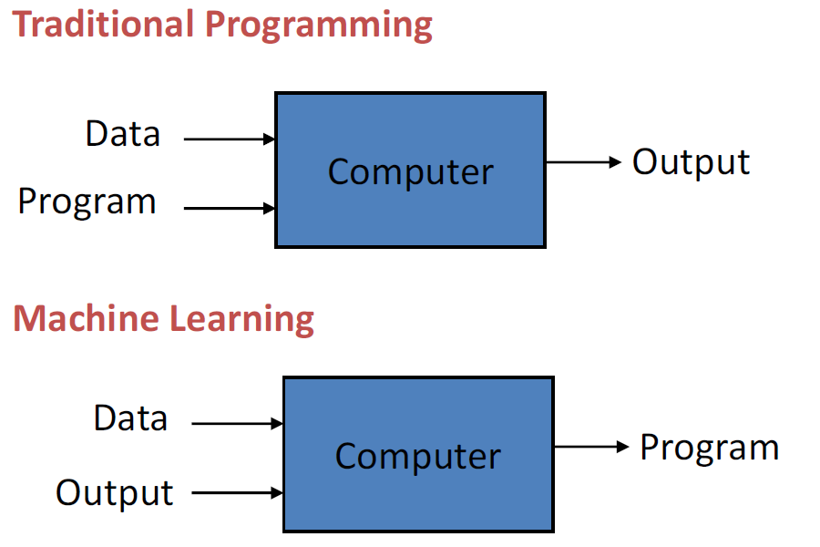
AI vs Traditional Computing (2)
Recall that:

Slide 17
Common Domains of AI
Artificial Intelligence
Machine Learning
Natural Language Processing
Expert Systems
Neural Networks
Robotics
Computer Vision

Slide 18
Applications of Artificial Intelligence
AI has been dominant in various fields such as :
Gaming − AI plays crucial role in strategic games such as chess, poker, tic-tac-toe, etc., where machine can think of large number of possible positions based on heuristic knowledge.
Natural Language Processing − It is possible to interact with the computer that understands natural language spoken by humans.

Slide 19
Applications of AI (2)
Expert Systems − There are some applications which integrate machine, software, and special information to impart reasoning and advising. They provide explanation and advice to the users.
Vision Systems − These systems understand, interpret, and comprehend visual input on the computer. For example,
A spying aeroplane takes photographs, which are used to figure out map of the areas.
Doctors use clinical expert system to diagnose the patient.

Slide 20
Applications of AI (3)
Speech Recognition − Some intelligent systems are capable of hearing and comprehending the language in terms of sentences and their meanings while a human talks to it.
Handwriting Recognition − The handwriting recognition software reads the text written on paper by a pen or on screen by a stylus. It can recognize the shapes of the letters and convert it into editable text.

Slide 21
Applications of AI (4)
Intelligent Robots − Robots are able to perform the tasks given by a human. They have sensors to detect physical data from the real world such as light, heat, temperature, movement, sound, bump, and pressure. They have efficient processors, multiple sensors and huge memory, to exhibit intelligence. In addition, they are capable of learning from their mistakes and they can adapt to the new environment.

Slide 22
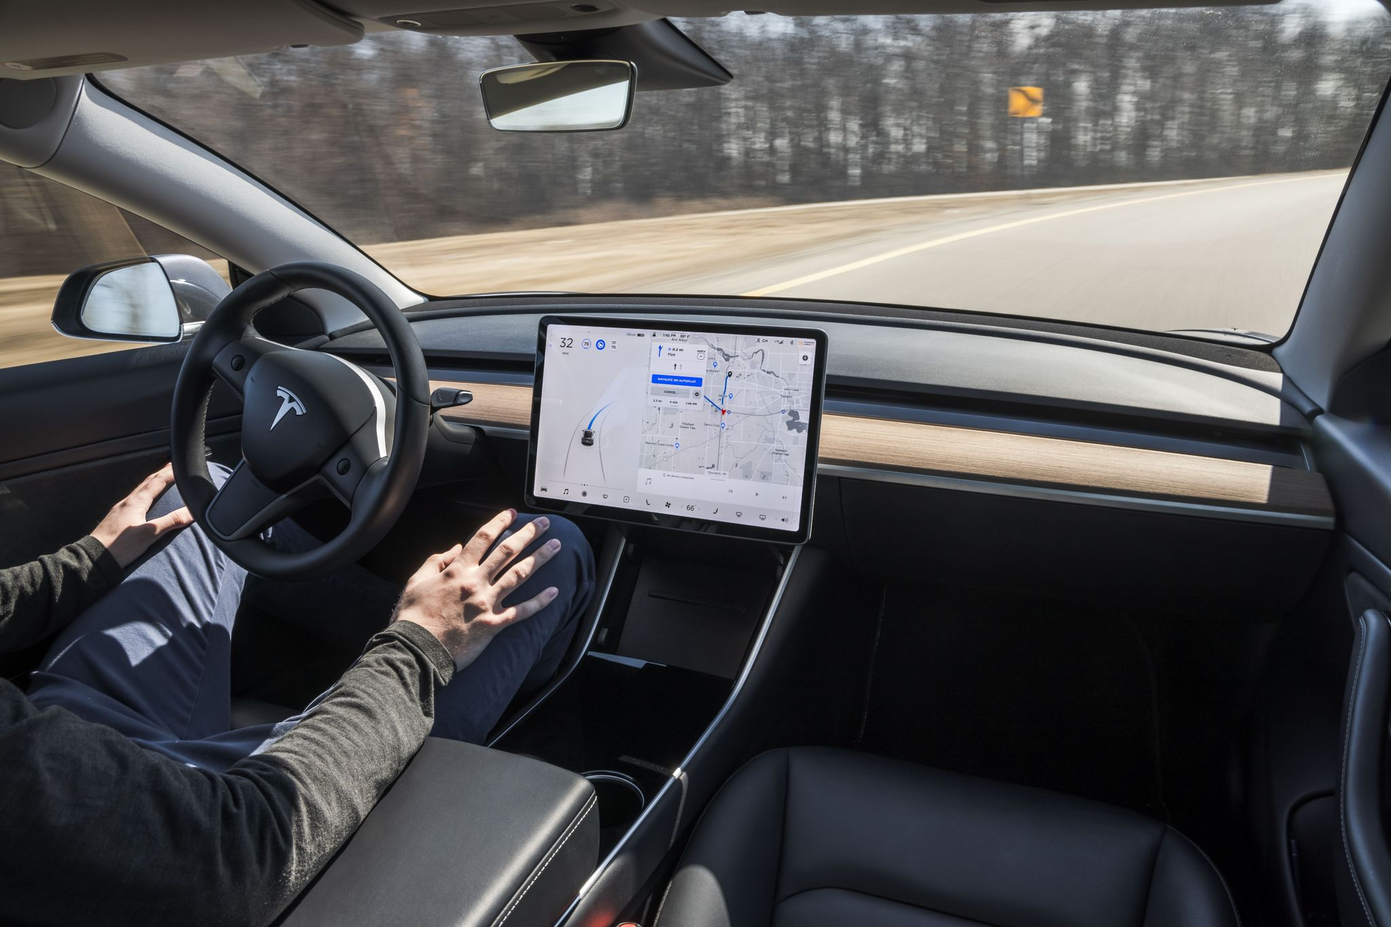
Autonomous Driving

Slide 23
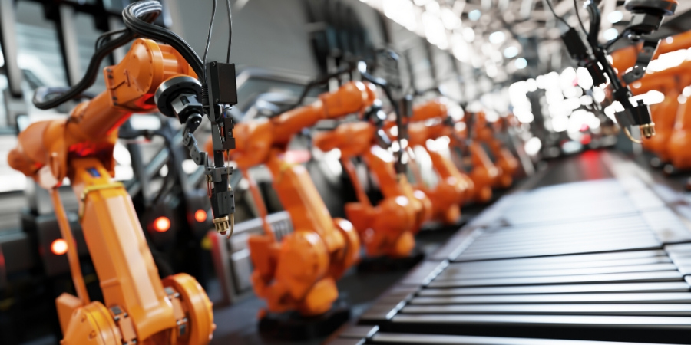
Robotics and Automation

Slide 24
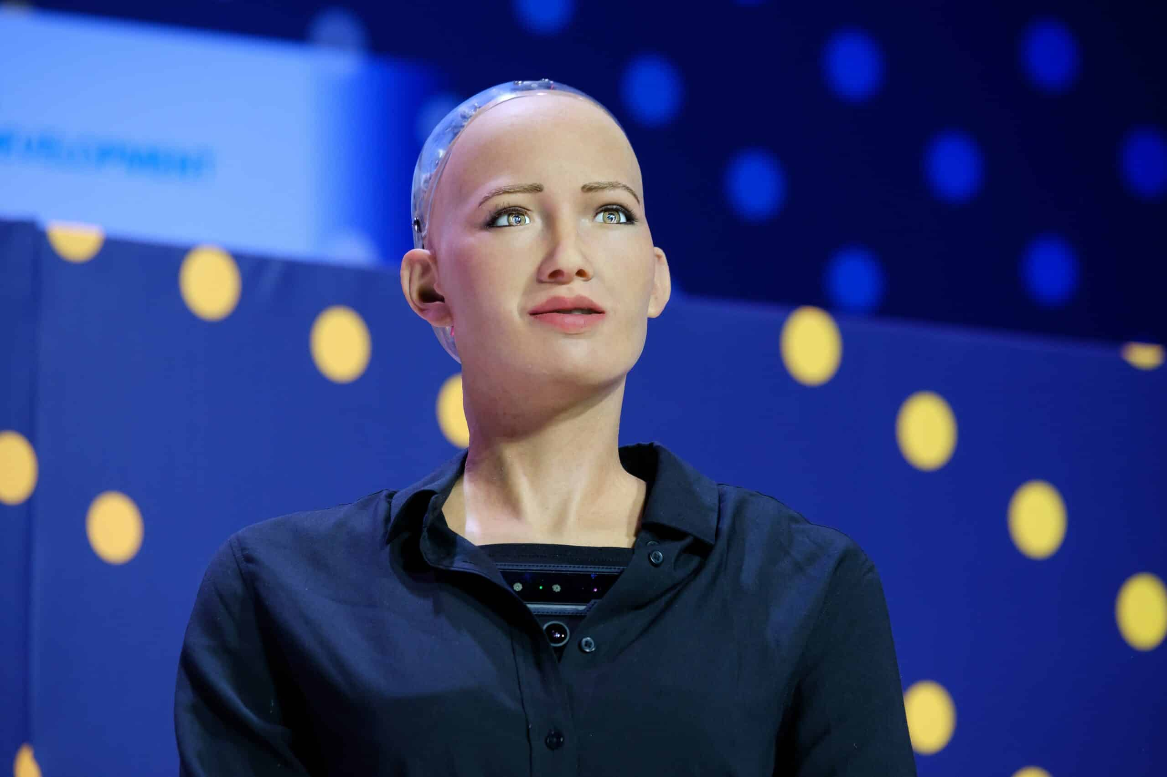
Natural Language Processing

Slide 25
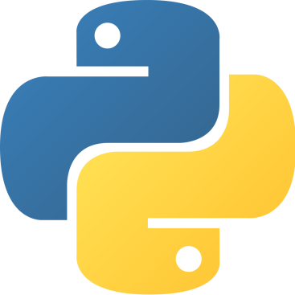
2. Python Basics
What is Python?
Why Python?
Timeline of Programming Languages
Applications for Python

Slide 26

What is Python?
Python is a widely used high-level, general-purpose, interpreted, dynamic programming language.
Its design philosophy emphasizes code readability, and its syntax allows programmers to express concepts in fewer lines of code than possible in languages such as C++ or Java.
The language provides constructs intended to enable clear programs on both a small and large scale.

Slide 27
What is Python? (2)
Python
def hello():
print("Hello World!")
Java
class HelloWorld {
public static void main(String args{}) {
System.out.println("Hello World!");
}
}
C++
#include <iostream.h>
main() {
cout << "Hello World!" << endl;
return 0;
}

Slide 28
Why Python?
Python has become the lingua franca for many data science applications.
It combines the power of general-purpose programming languages with the ease of use of domain-specific scripting languages like MATLAB or R.
Python has libraries for data loading, visualization, statistics, natural language processing, image processing, and more.

Slide 29
Why Python?
This vast toolbox provides data scientists with a large array of general- and special-purpose functionality.
One of the main advantages of using Python is the ability to interact directly with the code, using a terminal or other tools like the Jupyter Notebook, which we’ll look at shortly.
Machine learning and data analysis are fundamentally iterative processes, in which the data drives the analysis.

Slide 30
Why Python?
It is essential for these processes to have tools that allow quick iteration and easy interaction.
As a general-purpose programming language, Python also allows for the creation of complex graphical user interfaces (GUIs) and web services, and for integration into existing systems.

Slide 31
Timeline of Programming Languages
1957
Fortran
1959
LISP
1960
COBOL
1964
BASIC
1970
Pascal
1972
C
Prolog
SQL
1980
Ada
1983
C++
1991
Python
1993
R
1995
Java
PHP
JavaScript

Slide 32
Applications for Python
Web and Internet Development
Database Access
Scientific and Numeric
Education
Desktop GUIs
Software & Game Development
Network Programming
Data Analysis
Machine Learning
Data Mining

Slide 33
3. Colaboratory
Google developed AI framework called TensorFlow and a development tool called Colaboratory.
Usually, we call it as Colab.
We can use it as a tool to write and run Python.
You need to have google account and use google drive.

Slide 34
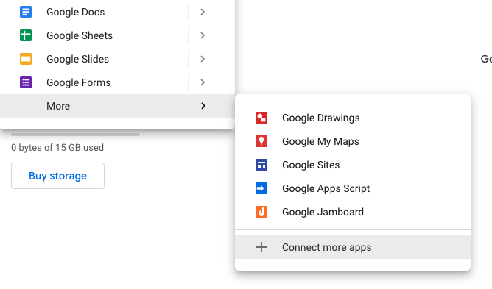
Installation of Colab
Click the "New" button on your Google Drive.
And then choose "More", "Connect More apps".

Slide 35
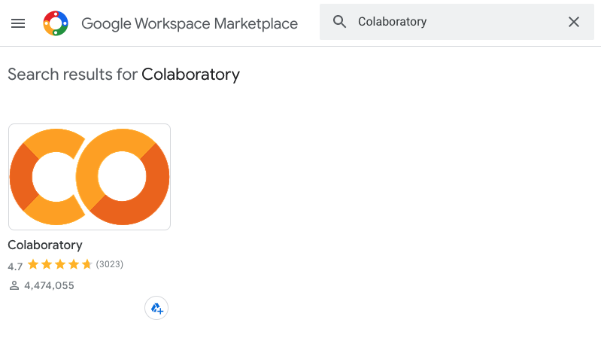
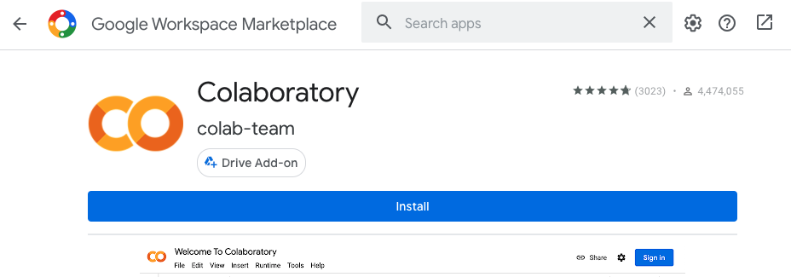
Installation of Colab
Search "Colaboratory" and then choose the app.
Finally, click the "Install" button.

Slide 36
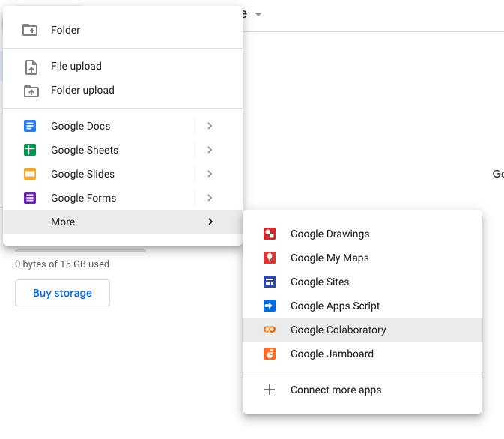
Start to use Colab
Click the "New" button on your Google Drive.
You can find Colab under the "More" menu.

Slide 37

Start to use Colab
Type "print('Hello World!')" under the text input box.
And then click the arrow button to run your code.

Slide 38
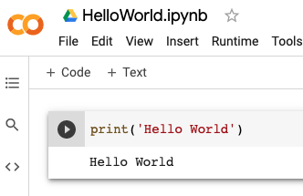
Start to use Colab
You can change the notebook name by single click on the default name "Untitled0.ipynb'.

Slide 39
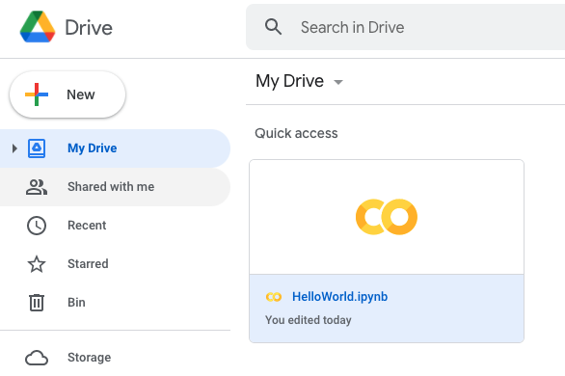
Start to use Colab
When you go back to your Google Drive, you will find your Colab Notebook.
You can open it again by using double click.

Slide 40
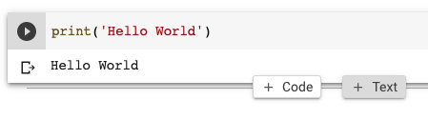
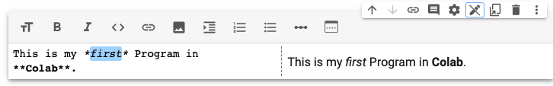
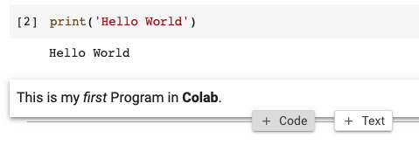
More operation in Colab
You can add a text to describe your code.
And then you can add more codes under the text.

Slide 41
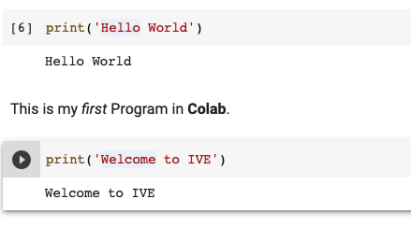
More operation in Colab
You can choose the menu "Runtime", "Run all" to run all the codes in your notebook.

Slide 42
4. Python Language Basics
Variables & Data Types
Casting
Relational Operators
Logical Operators
if
if … elif … else
while
for … in …
def a_function()
User Input

Slide 43
Variables & Data Types
Python Data Types:
Text Type: str
Numeric Types: int, float, complex
Sequence Types: list, tuple, range
Mapping Type: dictionary
Set Types: set, frozenset
Boolean Type: bool
Binary Types: bytes, bytearray, memoryview

Slide 44
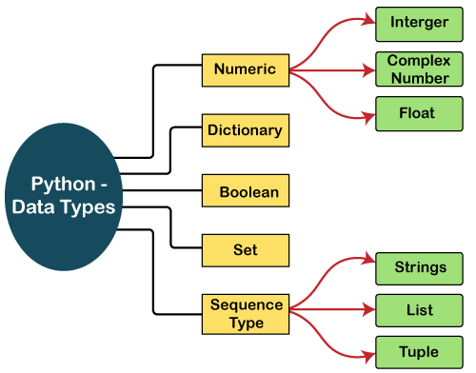
Variables & Data Types

Slide 45
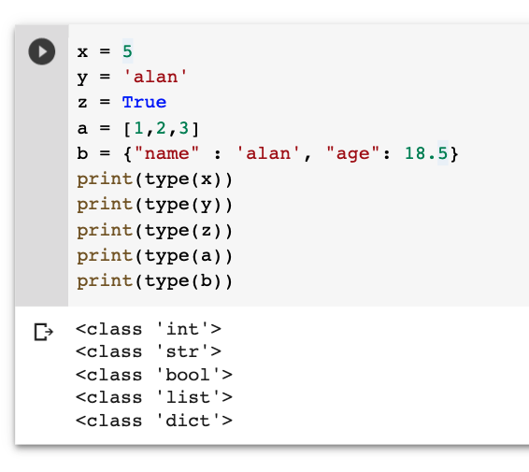
Variables & Data Types

Slide 46
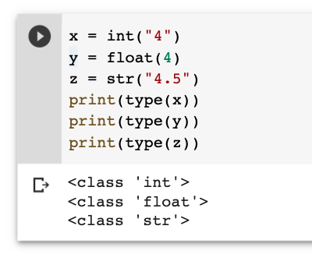
Casting

Slide 47
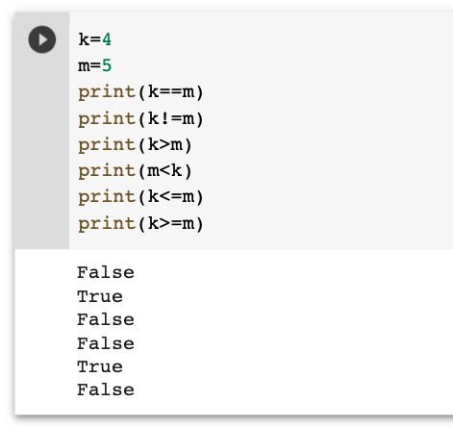
Relational Operators
Binary operators for comparing two values
Returns either True or False

Slide 48
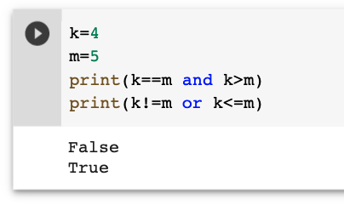
Logical Operators
Two logical operators: and, or

Slide 49
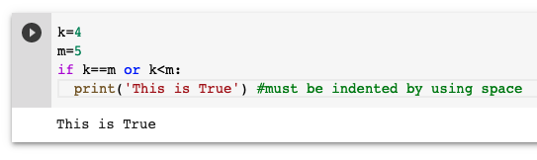
if
Python must use indentation (whitespace at the beginning of a line) to define scope in the code.

Slide 50
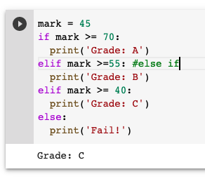
if … elif … else

Slide 51
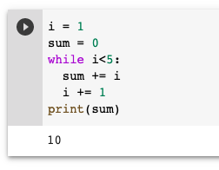
while

Slide 52
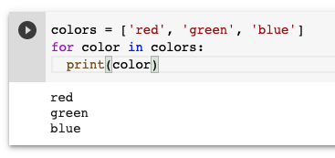
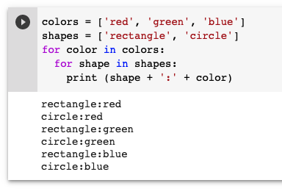
for … in ...
A for loop is used for iterating over a list, a tuple, a dictionary, a set, or a string.

Slide 53
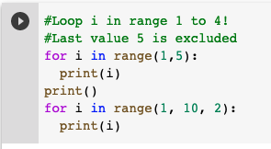

for … in range(begin, end, step)
You can use range(begin, end, step) function in for loop to get a sequential value.
By default, value of step is 1.

Slide 54
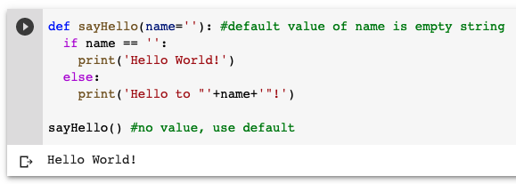
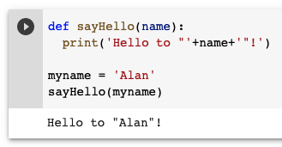
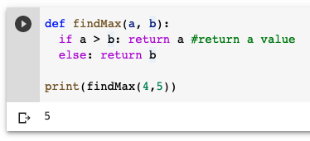
def a_function():

Slide 55
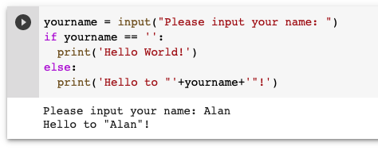
User Input: input(prompt)
You can use the built-in function input(prompt) with a prompt message to let user to input a value.

Slide 56
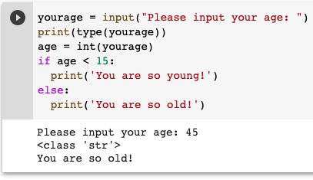
User Input: input (prompt)
The default data type of input() is str, you need to use casting to change the data type.

Slide 57
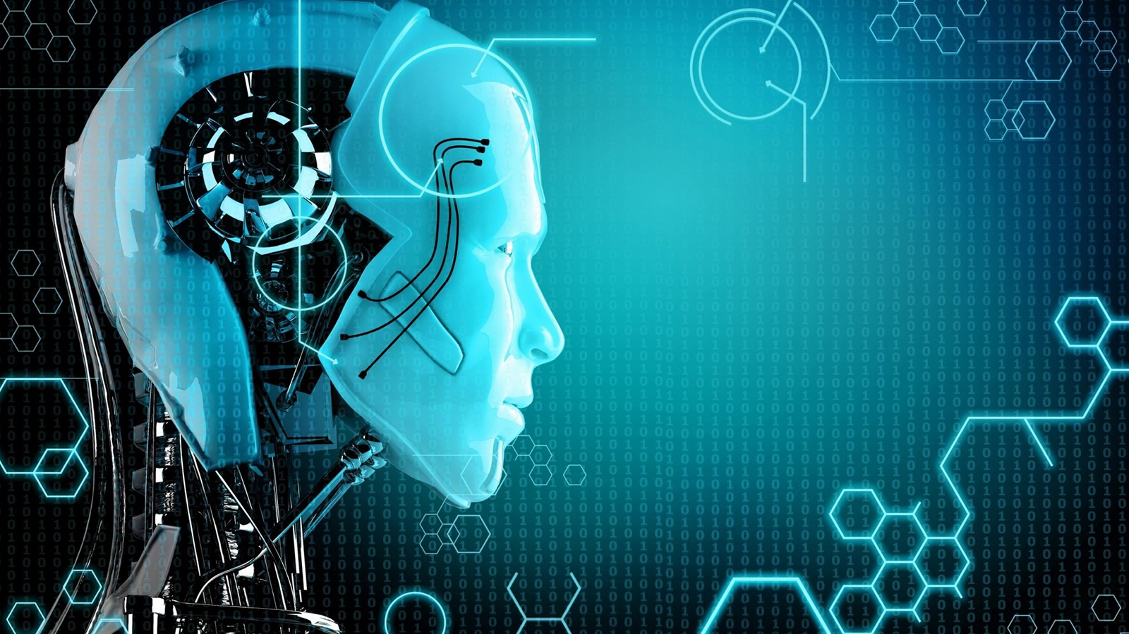
Self Study Guide

Slide 58
Self Study Guide
References
Joshir, P. (2017). Artificial Intelligence with Python (1st ed.). Birmingham: Packt Publishing.
Russell, S. and Norvig, P. (2010). Artificial Intelligence: A Modern Approach (3rd ed.). Upper Saddle River, NJ: Pearson.
Gaddis, T. (2018). Starting Out with Python (4th ed.). Pearson.
Useful Site
https://www.w3schools.com/python/

